Slide 1
Introduction
2CS702 Big Data Analytics
Prof Jigna Patel
N-5-FC3
Jignas.patel@nirmauni.ac.in
9898942993

Slide 2
Course Outcomes
After successful completion of this course, student will be able to
1. outline the significance and challenges of big data
2. model big data using different tools and frameworks
3. apply big data techniques for useful business analytic applications
4. design algorithms for mining the data from large volumes

Slide 3
Syllabus
Unit I
Introduction to Big Data: Evolution of Big Data, Types of Digital Data, Classification of Digital Data, Structured Data, Semi-Structured Data, Unstructured Data, Definition of Big Data, Challenges of Conventional Systems, Big data platforms and data storage
Unit II
Big Data Analytics: Importance of Big data analytics, Classification of Analytics, Top Challenges Facing Big Data, Technologies to meet the Challenges Posed by Big Data, Terminologies Used in Big Data Environment
Unit III
Hadoop: Introducing Hadoop, comparisons of RDBMS and Hadoop, Distributed Computing Challenges, Hadoop Overview, Business Value of Hadoop, Hadoop Distributed File System, Processing Data with Hadoop, working with Map Reduce,
Hadoop YARN, Hadoop in the Cloud, Applications on Big Hadoop Ecosystem, Fundamentals of Pig, Hive, HBase and ZooKeeper, Basic concepts of Apache Spark
Unit IV
The Big data technology landscape: CAP Theorem - BASE Concept, NoSQL, Types of No SQL databases, Introduction to MongoDB, Data Types in MongoDB, CRUD, Apache Cassandra, Features of Cassandra, CRUD
Unit V
Big data analytics Algorithm: Applying Linear Regression, Clustering, Association rule mining, Decision tree on Big Data.
Self-study: Frameworks: Applications on Big Data Using Pig and Hive

Slide 4
References:
Michael Berthold, David J. Hand, Intelligent Data Analysis, Springer
Tom White, Hadoop: The Definitive Guide, Third Edition, O’reilly Media
Chris Eaton, Dirk DeRoos, Tom Deutsch, George Lapis, Paul Zikopoulos, Understanding Big Data: Analytics for Enterprise Class Hadoop and Streaming Data, McGraw Hill Publishing
Anand Rajaraman and Jeffrey David Ullman, Mining of Massive Datasets, Cambridge University Press
Bill Franks, Taming the Big Data Tidal Wave: Finding Opportunities in Huge Data Streams with Advanced Analytics, John Wiley & sons
Glenn J. Myatt, Making Sense of Data, John Wiley & Sons
Pete Warden, Big Data Glossary, O’Reilly
Jiawei Han, Micheline Kamber, Data Mining Concepts and Techniques, Second Edition, Elsevier
Da Ruan, Guoquing Chen, Etienne E.Kerre, GeertWets, Intelligent Data Mining, Springer
Paul Zikopoulos, Dirk deRoos, Krishnan Parasuraman, Thomas Deutsch, James Giles, David Corrigan, Harness the Power of Big Data The IBM Big Data Platform, Tata McGraw Hill Publications
Michael Minelli, Michele Chambers, Ambiga Dhiraj, Big Data, Big Analytics: Emerging Business Intelligence and Analytic Trends for Today's Businesses, Wiley Publications
Zikopoulos, Paul, Chris Eaton, Understanding Big Data: Analytics for Enterprise Class Hadoop and Streaming Data, Tata McGraw Hill Publications
Seema Acharya and Subhashini C, Big Data and Analytics, Wiley India

Slide 5
Lab session guidelines

Slide 6
InClassQuestion#1
What is the need to learn this subject?

Slide 7
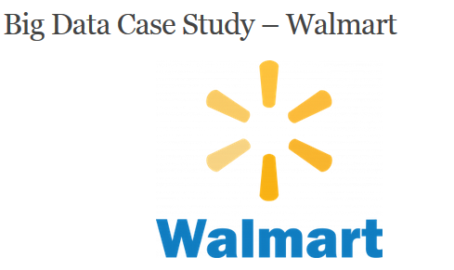
Big Data popular case study
1)
Reference : https://data-flair.training/blogs/big-data-case-studies/

Slide 8
More than 2 million employees and 20000 stores in 28 countries
Walmart uses Data Mining to discover patterns that can be used to provide product recommendations to the user, based on which products were brought together.
Walmart by applying effective Data Mining has increased its conversion rate of customers. It has been speeding along big data analysis to provide best-in-class e-commerce technologies with a motive to deliver superior customer experience.
To optimize the shopping experience of customers when they are in a Walmart store.
Redesigning global websites and building innovative applications to customize the shopping experience for customers whilst increasing logistics efficiency.
Hadoop and NoSQL technologies are used to provide internal customers with access to real-time data collected from different sources and centralized for effective use.

Slide 9
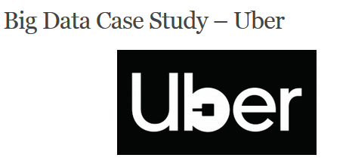
2)

Slide 10
Uber is the first choice for people around the world when they think of moving people and making deliveries.
It uses the personal data of the user to closely monitor which features of the service are mostly used, to analyse usage patterns and to determine where the services should be more focused.
Uber focuses on the supply and demand of the services due to which the prices of the services provided changes. Therefore one of Uber’s biggest uses of data is surge pricing. For instance, if you are running late for an appointment and you book a cab in a crowded place then you must be ready to pay twice the amount.
For example, On New Year’s Eve, the price for driving for one mile can go from 200 to 1000. In the short term, surge pricing affects the rate of demand, while long term use could be the key to retaining or losing customers. Machine learning algorithms are considered to determine where the demand is strong.

Slide 11
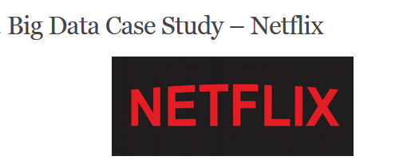
3)

Slide 12
It is the most loved American entertainment company specializing in online on-demand streaming video for its customers.
Netflix has been determined to be able to predict what exactly its customers will enjoy watching with Big Data.
As such, Big Data analytics is the fuel that fires the ‘recommendation engine’ designed to serve this purpose.
More recently, Netflix started positioning itself as a content creator, not just a distribution method.
The company’s data structure includes Hadoop, Hive and Pig with much other traditional business intelligence.
Netflix shows us that knowing exactly what customers want is easy to understand if the companies just don’t go with the assumptions and make decisions based on Big Data.

Slide 13
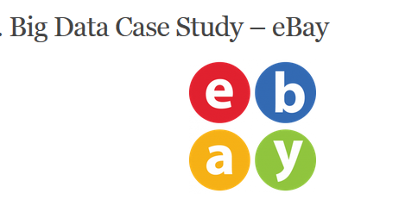
4)

Slide 14
A big technical challenge for eBay as a data-intensive business to exploit a system that can rapidly analyze and act on data as it arrives (streaming data).
There are many rapidly evolving methods to support streaming data analysis.
eBay is working with several tools including Apache Spark, Storm, Kafka.
It allows the company’s data analysts to search for information tags that have been associated with the data (metadata) and make it consumable to as many people as possible with the right level of security and permissions (data governance).
The company has been at the forefront of using big data solutions and actively contributes its knowledge back to the open-source community

Slide 15

5)

Slide 16
It is a 179-year-old company.
The genius company has recognized the potential of Big Data and put it to use in business units around the globe.
P&G has put a strong emphasis on using big data to make better, smarter, real-time business decisions.
The Global Business Services organization has developed tools, systems, and processes to provide managers with direct access to the latest data and advanced analytics. Therefore P&G being the oldest company, still holding a great share in the market despite having many emerging companies

Slide 17
InClassQuestion#2
How can we apply Big data Analytics in Education Sector?

Slide 18
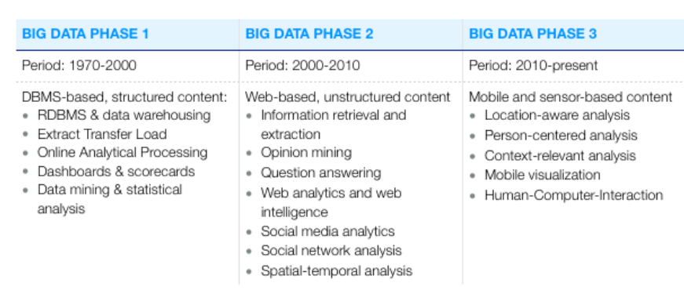
Reference : https://www.bigdataframework.org/short-history-of-big-data/

